Slide 1
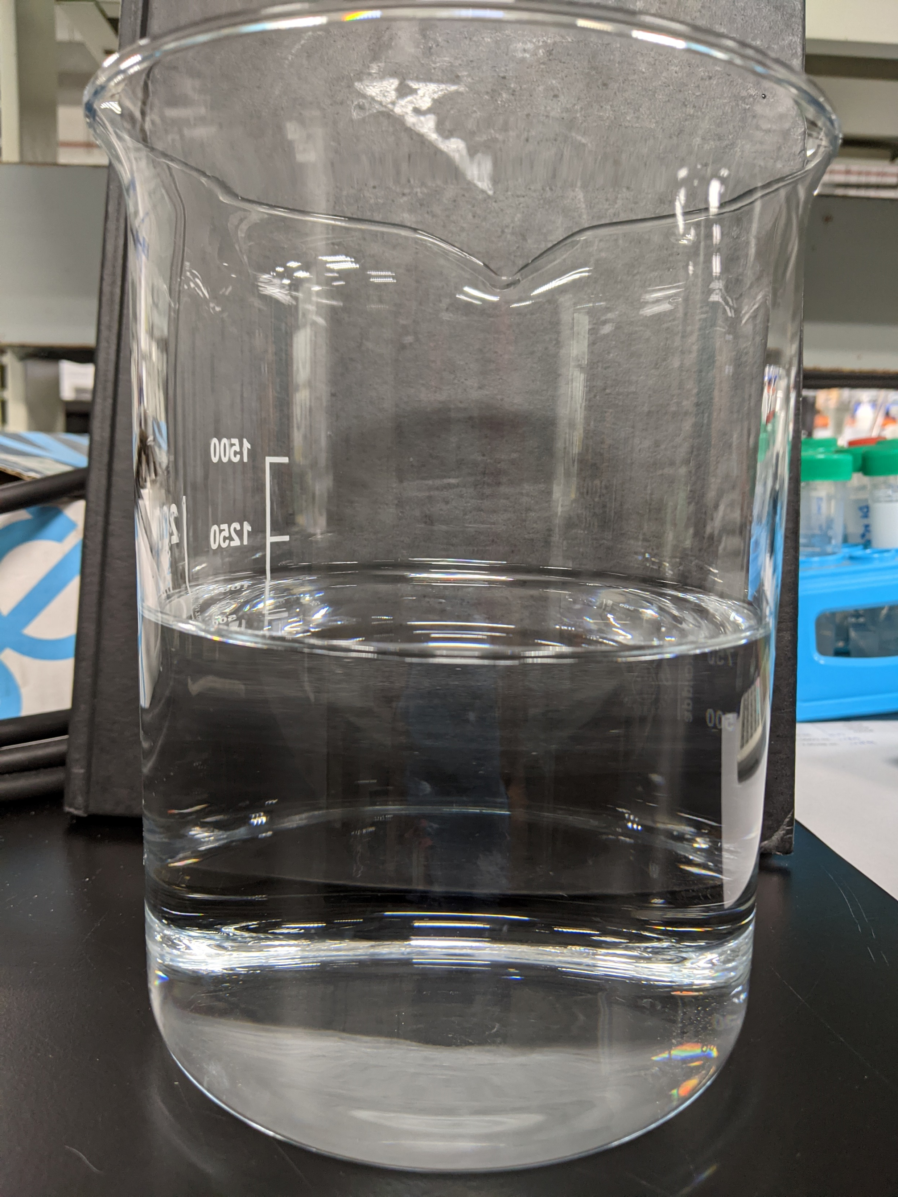
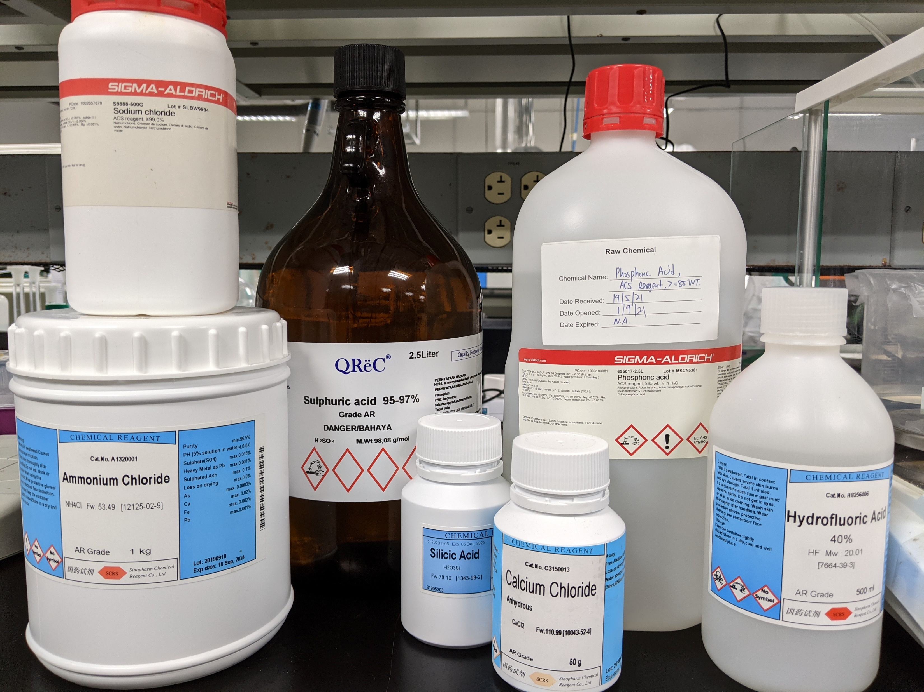
Preparation of Synthetic HFW+NH4F Solution (with pH adjustment)
Preferred chemicals | Required quantity for 1 Liter solution (gram)
NH4Cl | 0.059
NaCl | 0.013
CaCl2 | 0.014
HF | 0.843
H3PO4 | 0.206
SiH2O3 | 0.039
H2SO4 | 0.102
Elements | Desired concentration (ppm) | Calculated concentration based on added chemicals (ppm) | Concentration based on in-house measurement (ppm)
pH | 3.5 | - | 3.5
Conductivity | - | - | 2,481 µS/cm
TDS | - | - | 1,263
NH4 | 20 | 20 | 19.2
F | 800 | 800 | 789
SO4 | 100 | 100 | 98
PO4 | 200 | 200 | 205
Cl | 50 | 55.86 | 62.9
Na | 5 | 5 | 339
Ca | 5 | 5 | 4.05
Si | 14.02 | 14.02 | 16.2

Slide 2
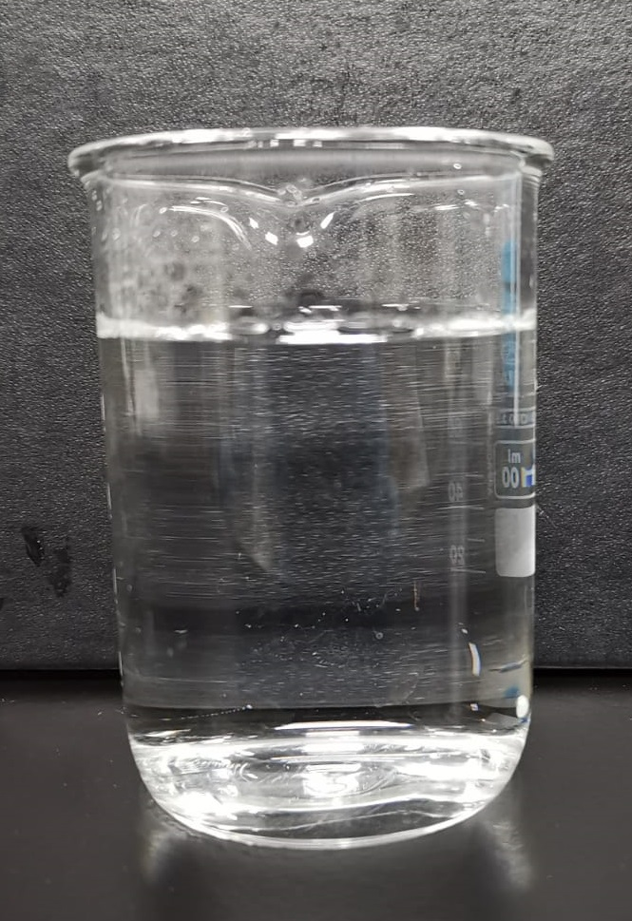
Preparation of Synthetic Combined NF RO Reject Solution (with pH adjustment)
Preferred chemicals | Required quantity for 1 Liter solution (gram)
NH4Cl | 0.210
NaCl | 0.064
CaCl2 | 0.049
HF | 2.986
H3PO4 | 0.367
SiH2O3 | 0.138
H2SO4 | 0.362
Elements | Desired concentration (ppm) | Calculated concentration based on added chemicals (ppm) | Concentration based on in-house measurement (ppm)
pH | 3.5 | - | 3.5
Conductivity | - | - | 6,375 µS/cm
TDS | - | - | 3,394
NH4 | 70.8 | 70.8 | 65.8
F | 2,835 | 2,835 | 2,928
SO4 | 355 | 355 | 345
PO4 | 356 | 356 | 366
Cl | 209 | 209 | 211
Na | 2,790 | 24.99 | 500
Ca | 17.7 | 17.7 | 11.1
Si | 49.5 | 49.5 | 47.6

Slide 3
Jar testing Procedure
To each testing jar, pour in 1L of wastewater sample
To each jar, dose in 7000/7500/8000 mg/L of Ca(OH)2 and rapid mix for 30s
Slow mix for 30 min, measure pH every 10 min
Dose 1mg/L for each of the SNF polymer (anionic) in each jar and further slower mix (30 rpm) for 30 min. Measure pH every 20 min
Stop mixing and leave the solids to settle over 60 min
Observe sludge settling and measure sludge height every 5 min (if applicable)
Measure turbidity of supernatant and collect the sludge
For the jar with the lowest supernatant turbidity reading, filter out the supernatant through 0.45 um filter and send for analysis and collect the sludge generated
For the sludge collected, filter out using 1.5 µm filter. Collect the sludge, dry sample for XRD analysis. Meanwhile, dissolve a pre-determined amount of collected sludge in acid and send for analysis

Slide 4
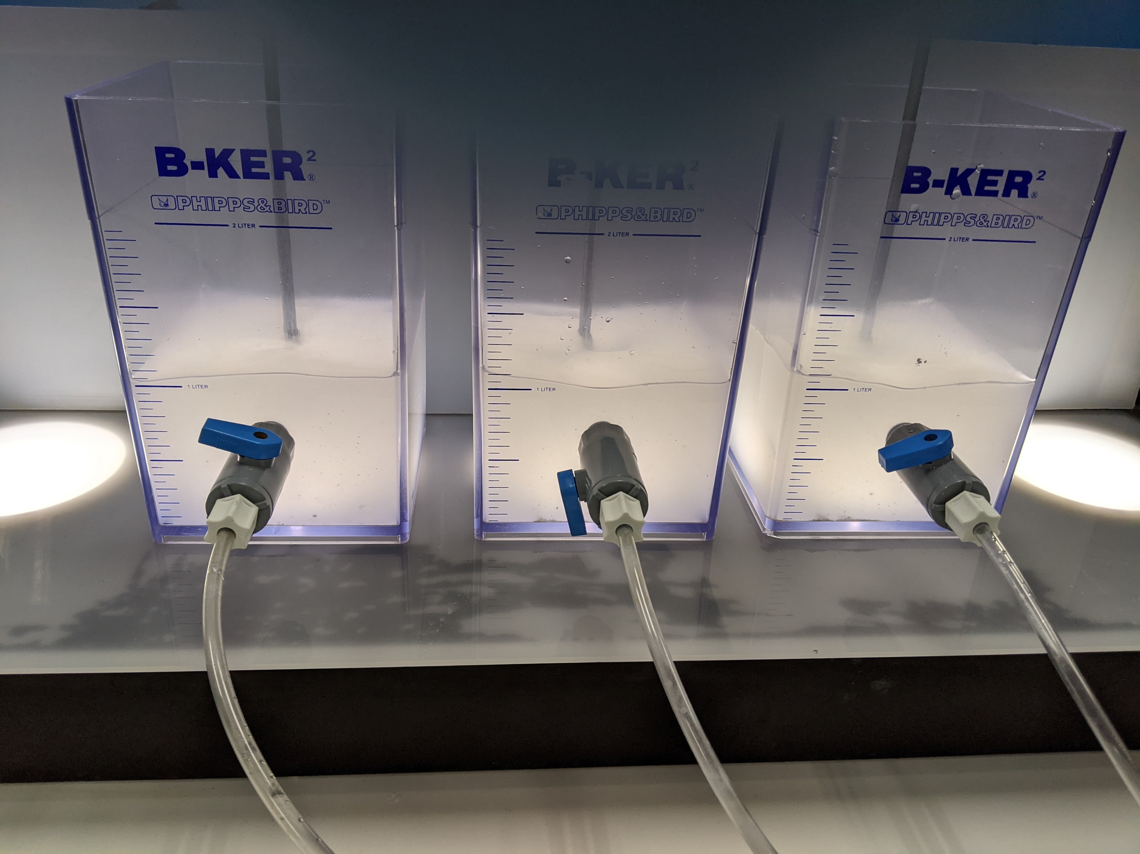
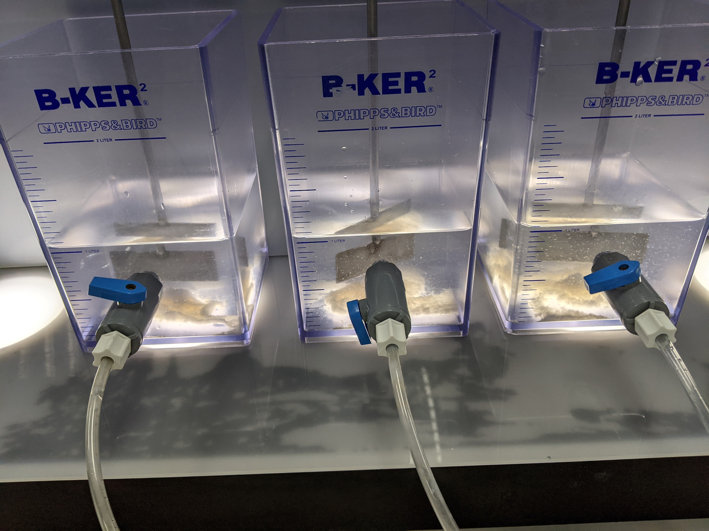
Jar testing of Synthetic HFW+NH4F with Lime (with pH adjustment)
Synthetic HFW+NH4F with added lime
Solution after the addition of Flocculant (precipitates clumped and settled in less than 1 min)

Slide 5
Jar testing of Synthetic HFW+NH4F with Lime (with pH adjustment)
Chemical precipitation with 2000 mg/L Ca(OH)2
Jar | pH
 | t = 10 min | t = 20 min | t = 30 min
1 | 9.6 | 11.2 | 11.55
2 | 10.8 | 11.54 | 11.75
3 | 10.4 | 11.46 | 11.74
Coagulation and flocculation with 1 mg/L anionic polymer
Jar | pH |  |  | Polymer used
 | t = 10 min | t = 20 min | t = 30 min
1 | 11.55 | 11.57 | 11.52 | Flopam AN 905 MPM
2 | 11.54 | 11.74 | 11.69 | Flopam AN 905 SH
3 | 11.63 | 11.72 | 11.62 | Flopam AN 934 SH

Slide 6
Jar testing of Synthetic HFW+NH4F with Lime (with pH adjustment)
Jar | Polymer added | Supernatant turbidity (NTU)
1 | Flopam AN 905 MPM | 0.73
2 | Flopam AN 905 SH | 0.55
3 | Flopam AN 934 SH | 0.44
Elements | Concentration based on in-house measurement (ppm) | Supernatant quality for Jar 3
pH | 3.5 | 11.62
Conductivity | 2,481 µS/cm | 1,715 µS/cm
TDS | 1,263 | 857.3
NH4 | 19.2 | 17
F | 789 | 131
SO4 | 98 | 82.6
PO4 | 205 | <1
Cl | 62.9 | 54.3
Na | 339 | 305
Ca | 4.05 | 17.8
Si | 16.2 | 6.53

Slide 7
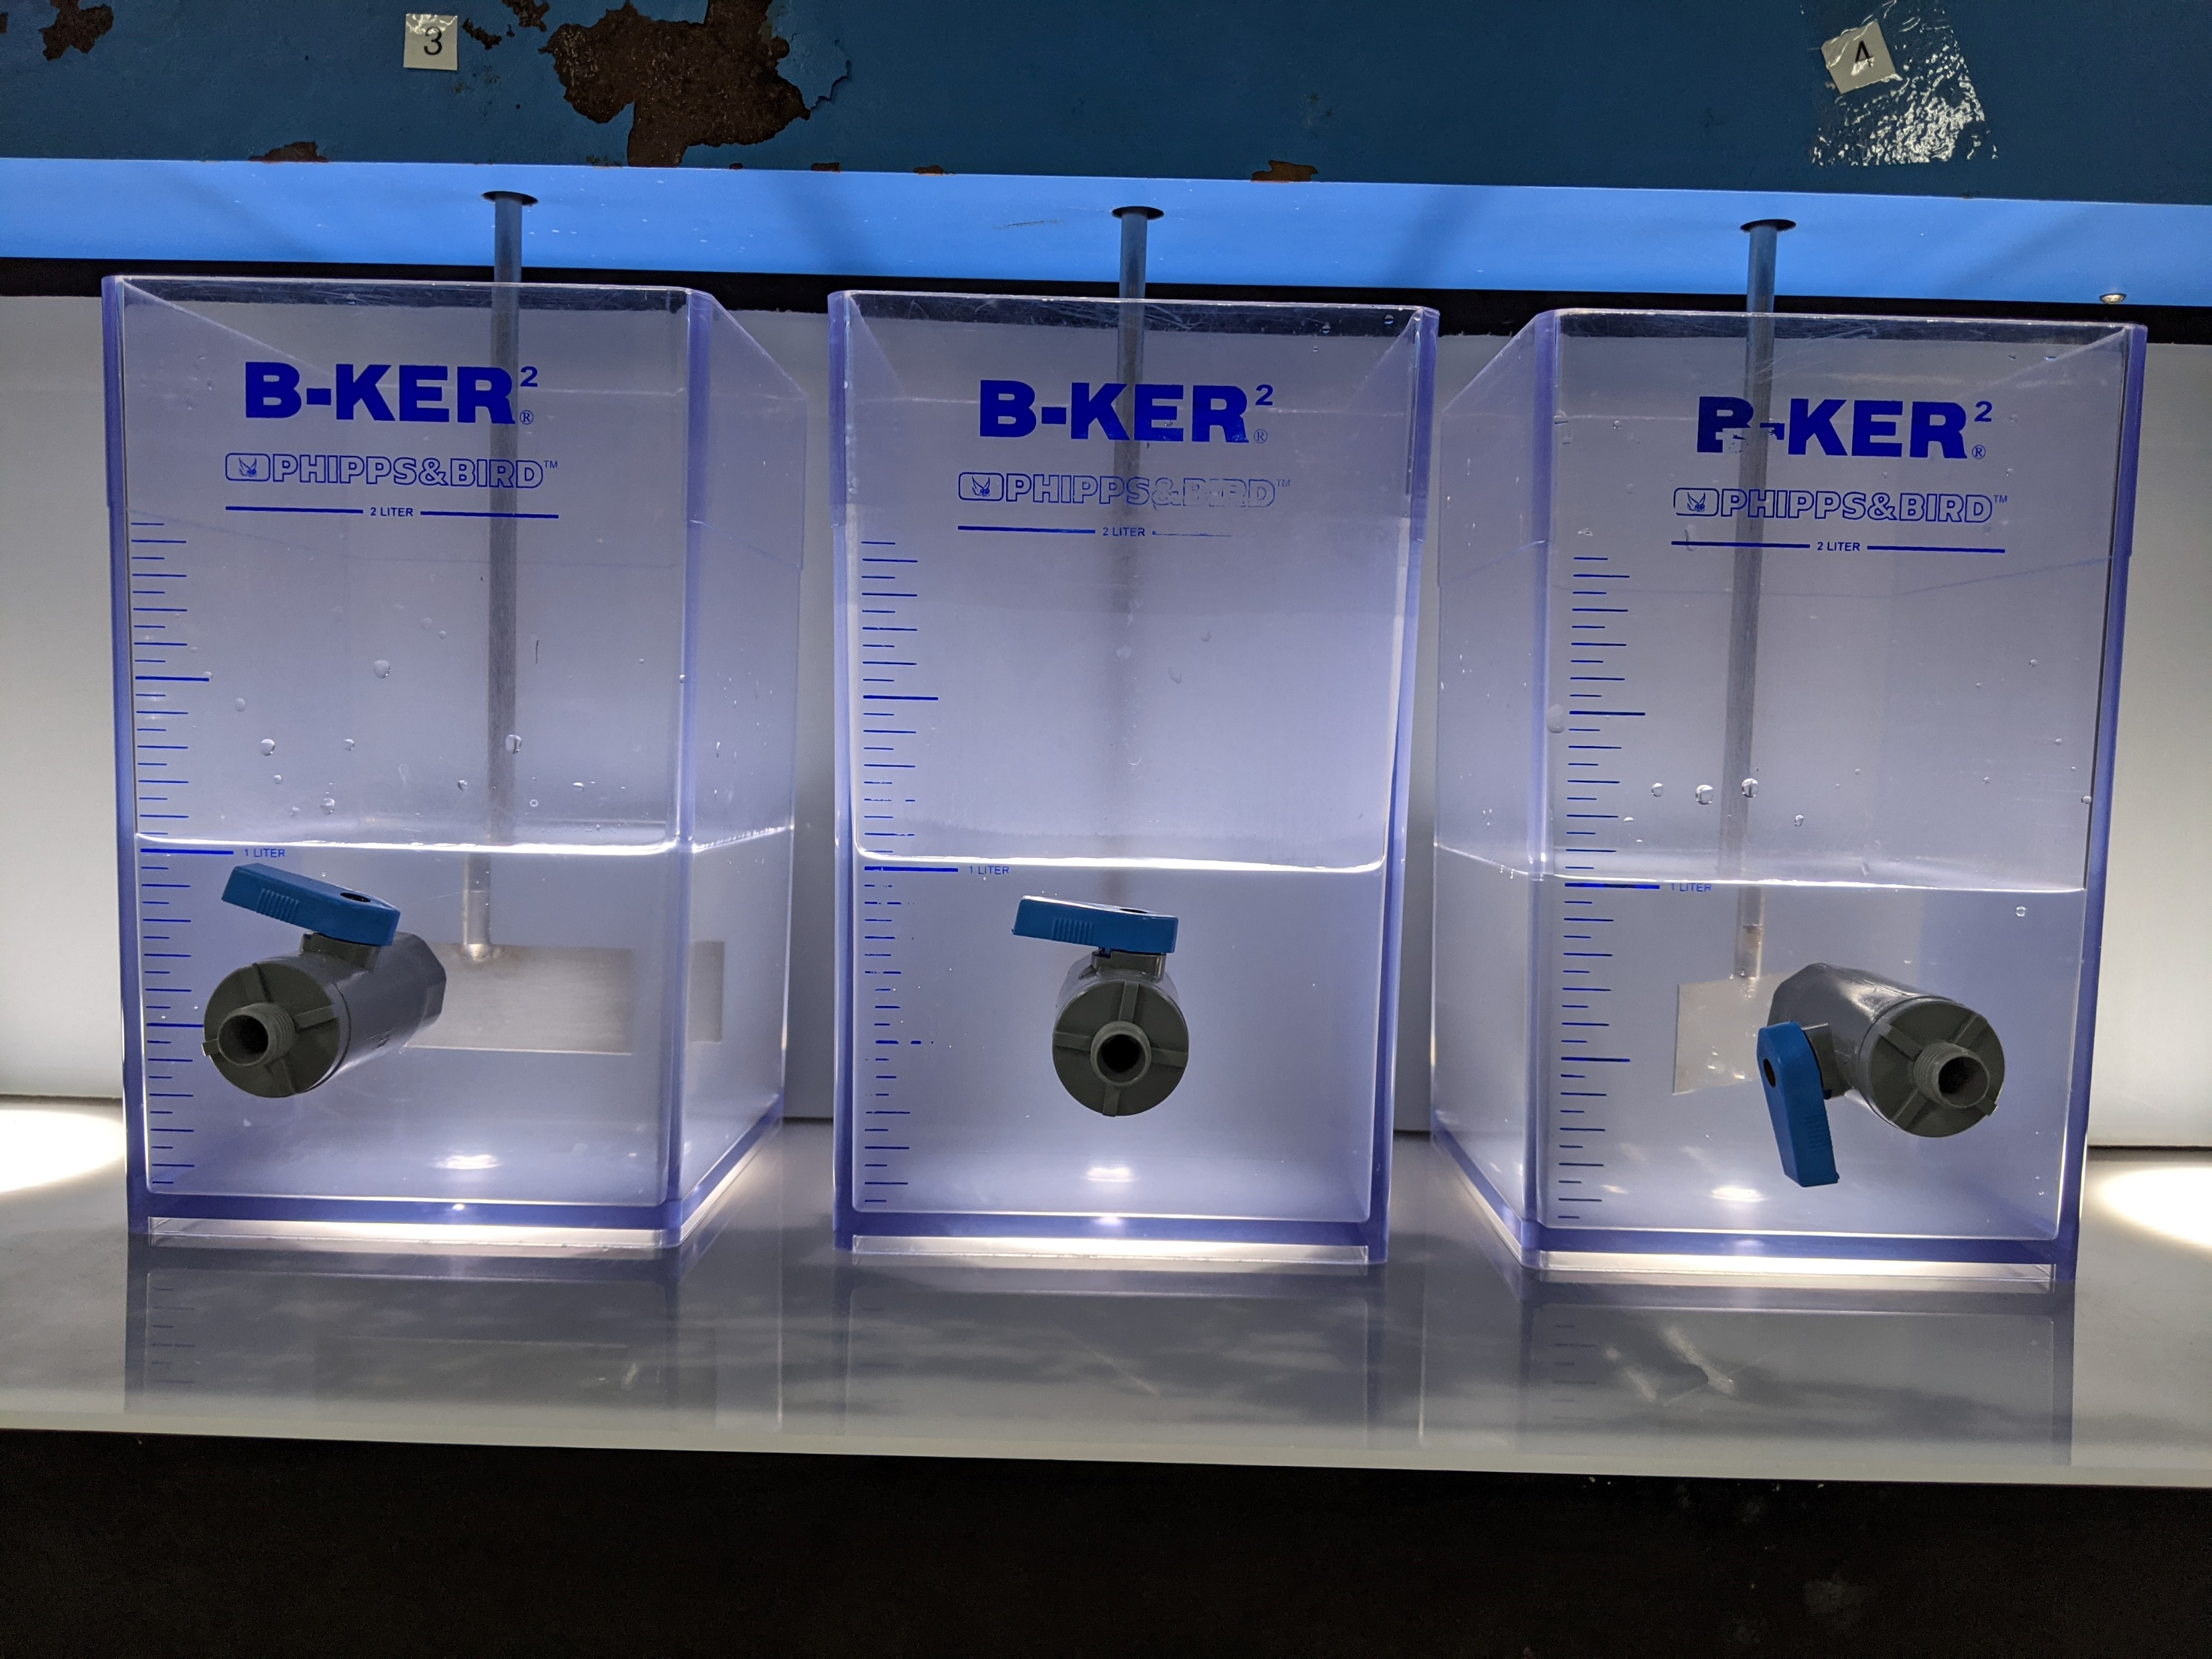
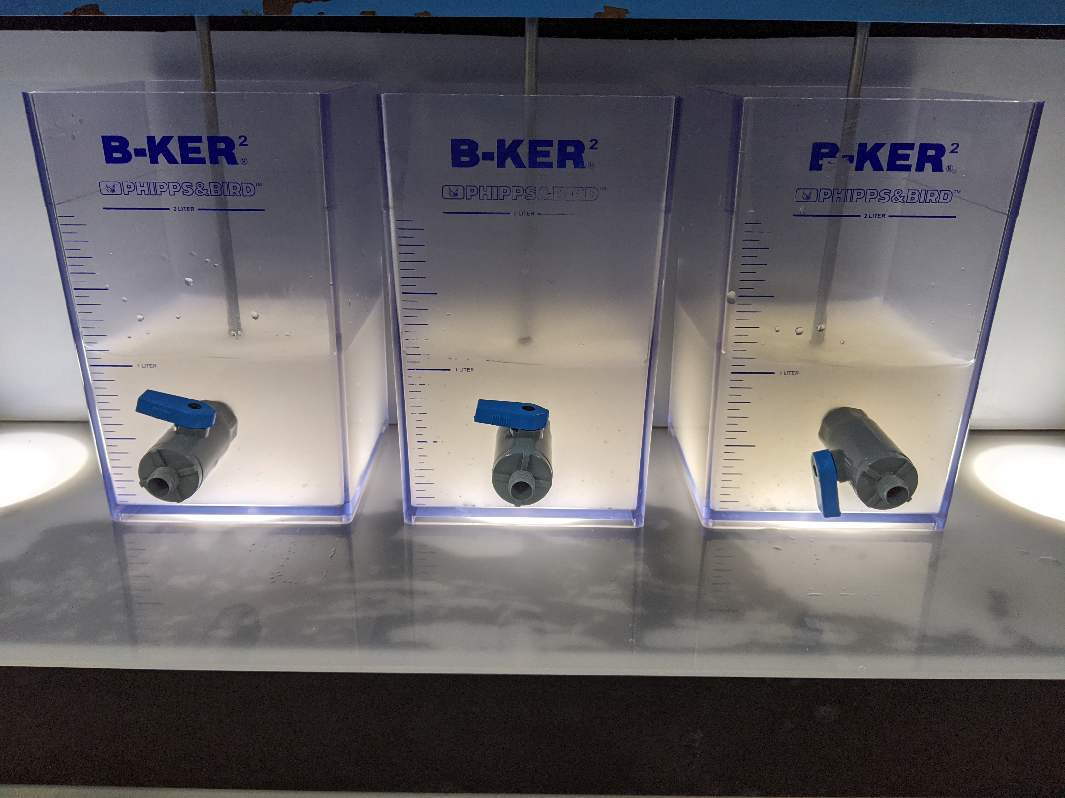
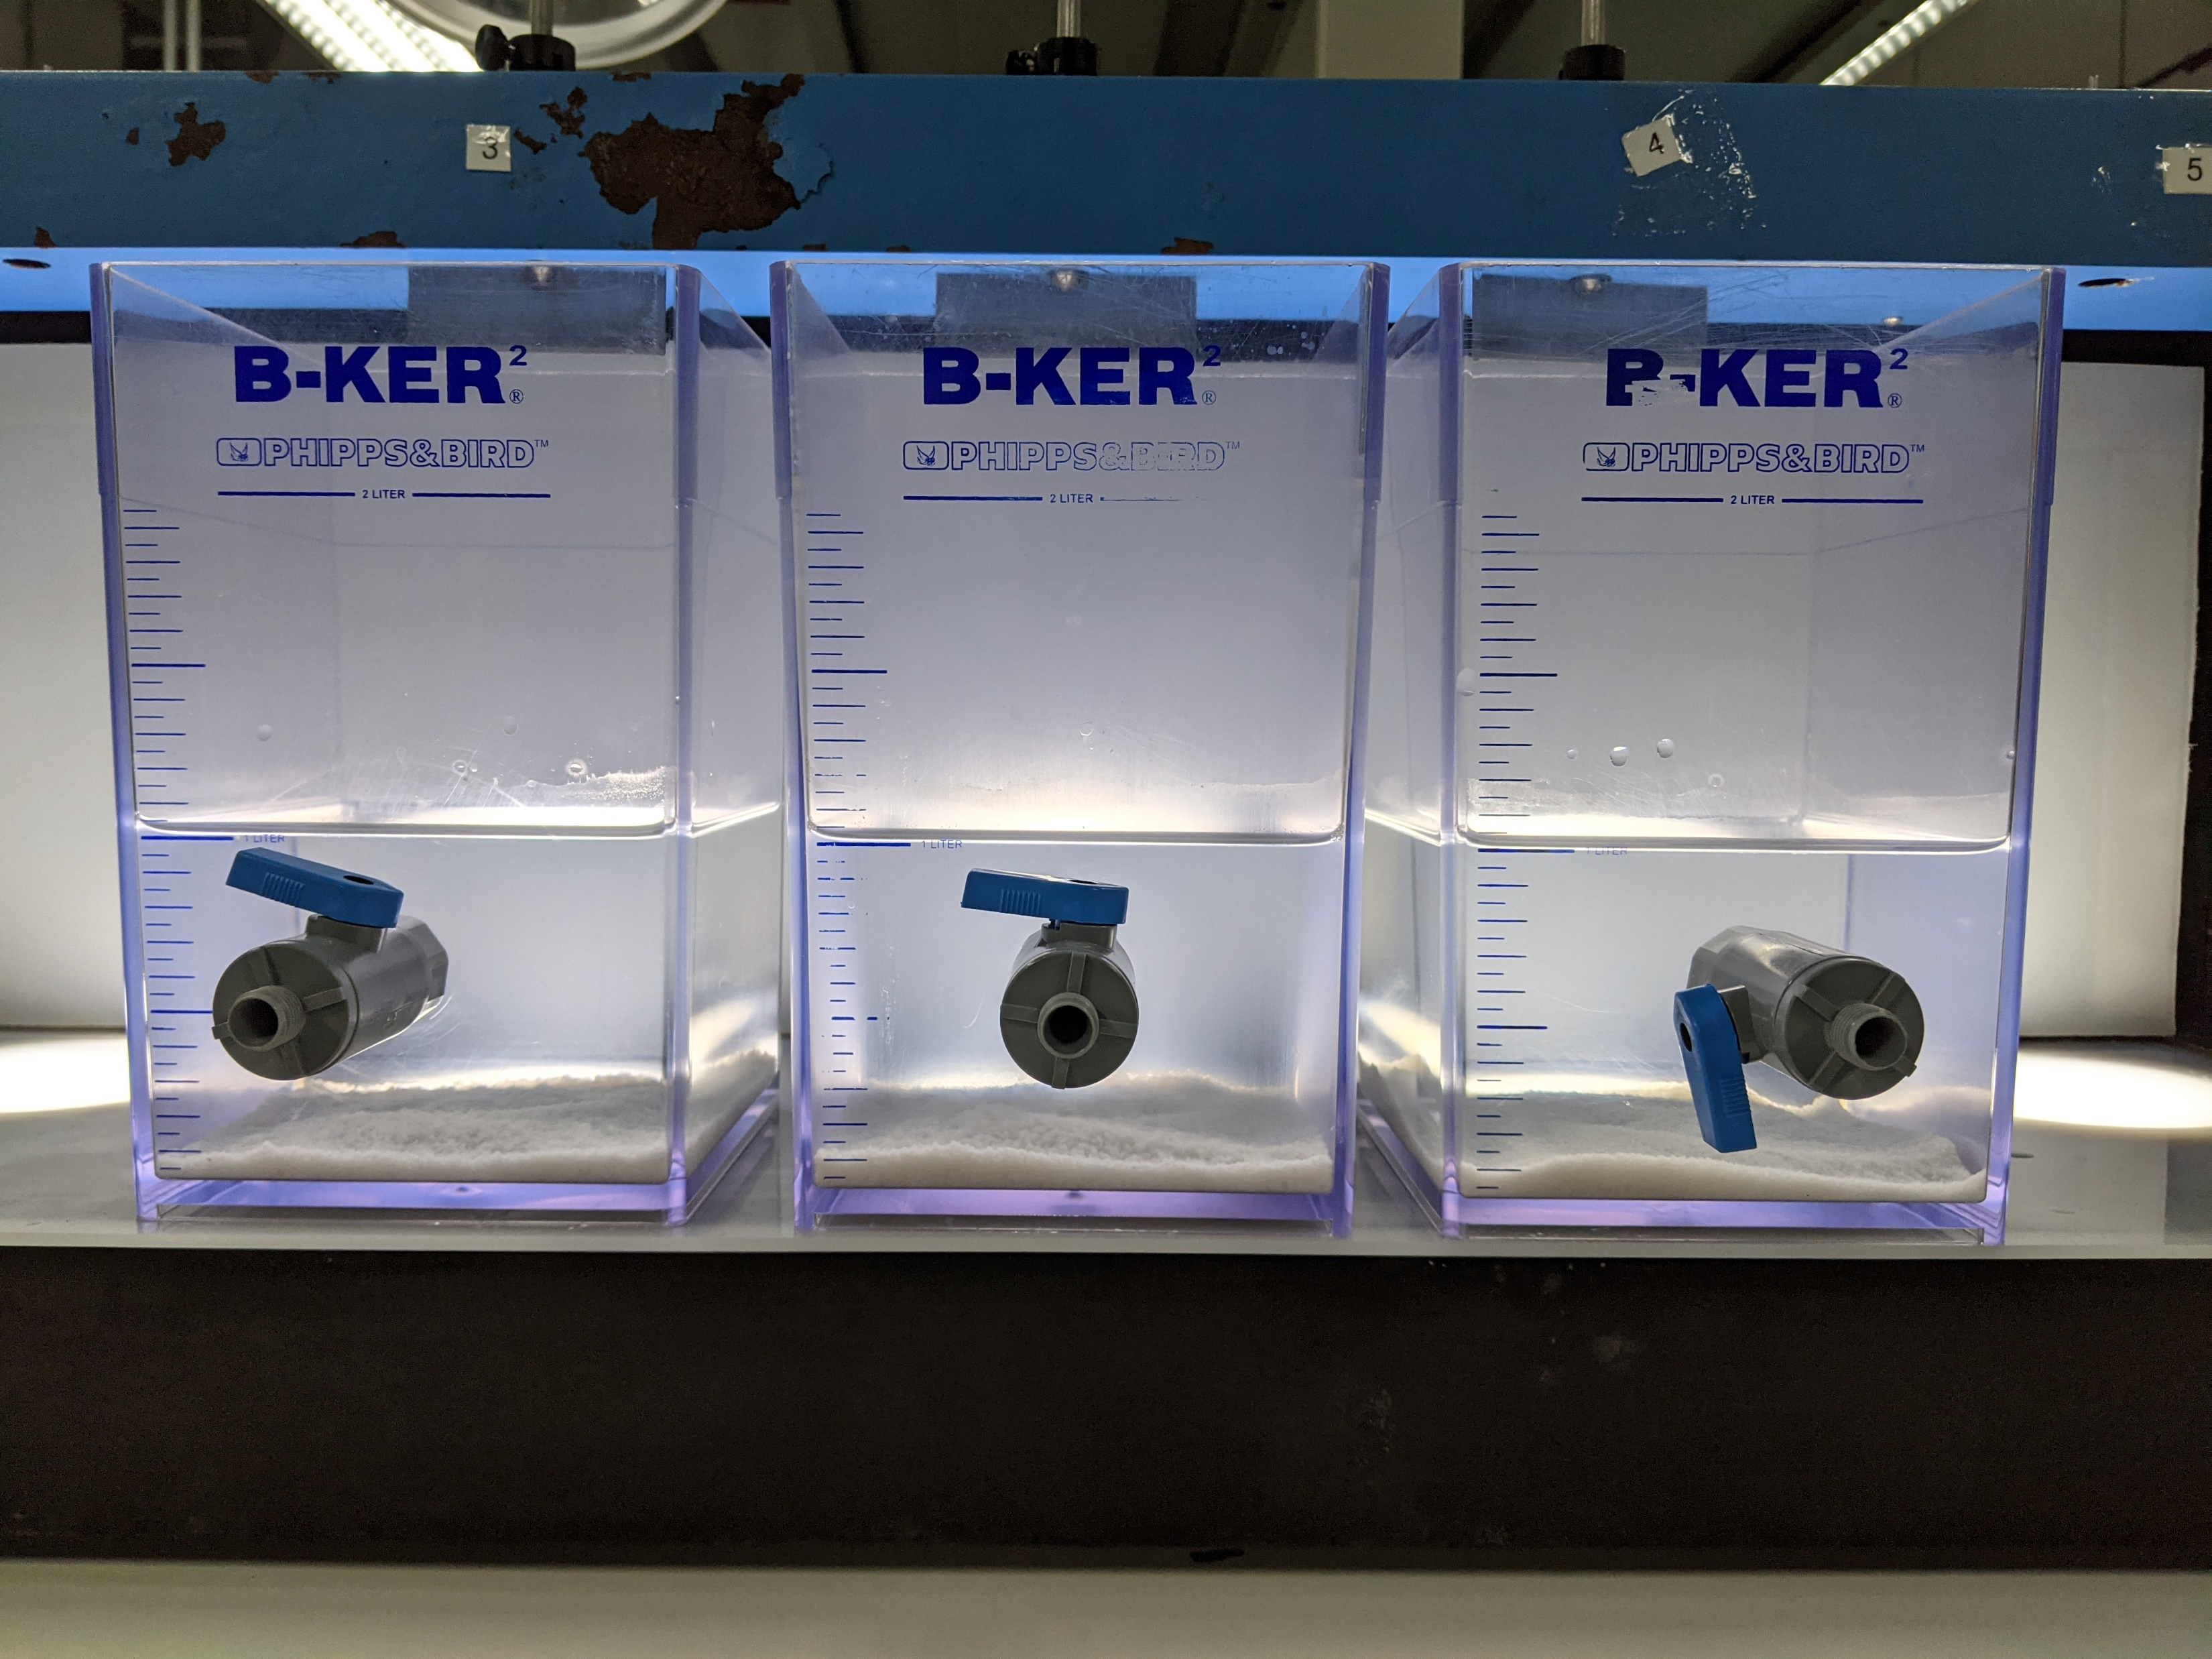
Jar testing of Synthetic Combined NF RO Reject (with pH adjustment) – Testing 1
Synthetic combined reject solution in different jars
Synthetic combined reject solution with added lime at different dosages (7000, 7500, 8000 ppm)
Solution with added flocculant (Flopam AN 934 SH). Precipitates clumped and settled after the addition of flocculant.

Slide 8
Jar testing of Synthetic Combined NF RO Reject (with pH adjustment) – Testing 1
Chemical precipitation with Ca(OH)2
Jar | Lime dosage (ppm) | pH
 |  | t = 15 min | t = 20 min | t = 30 min
1 | 7000 | 4.82 | 6.49 | 8.97
2 | 7500 | 9.98 | 11.08 | 11.46
3 | 8000 | 11.69 | 11.81 | 11.93
Coagulation and flocculation with 1 mg/L anionic polymer
Jar | Lime dosage (ppm) | pH |  |  | Polymer used
 |  | t = 10 min | t = 20 min | t = 30 min
1 | 7000 | 9.03 | 9.23 | 9.22 | Flopam AN 934 SH
2 | 7500 | 11.45 | 11.47 | 11.43 | Flopam AN 934 SH
3 | 8000 | 12.01 | 12.05 | 12.00 | Flopam AN 934 SH

Slide 9
Jar testing of Synthetic Combined NF RO Reject (with pH adjustment) – Testing 1
Jar | Polymer added | Lime dosage (ppm) | Supernatant turbidity (NTU)
1 | Flopam AN 934 SH | 7000 | 0.39
2 | Flopam AN 934 SH | 7500 | 0.33
3 | Flopam AN 934 SH | 8000 | 1.08
Elements | Concentration based on in-house measurement (ppm) | Supernatant quality for Jar 1 | Supernatant quality for Jar 2 | Supernatant quality for Jar 3
pH | 3.5 | 9.22 | 11.43 | 12
Conductivity | 6,375 µS/cm | 2,324 µS/cm | 2,338 µS/cm | 3,115 µS/cm
TDS | 3,394 | 1,177 | 1,185 | 1,603
NH4 | 65.8 | 67.4 | 55.7 | 51.6
F | 2,928 | 210 | 137 | 60.3
SO4 | 345 | 207 | 216 | 179
PO4 | 366 | <1 | <1 | <1
Cl | 211 | 192 | 194 | 194
Na | 500 | 493 | 459 | 478
Ca | 11.1 | 1.43 | 2.58 | 9.57
Si | 47.6 | 21.7 | 1.86 | 0.308

Slide 10
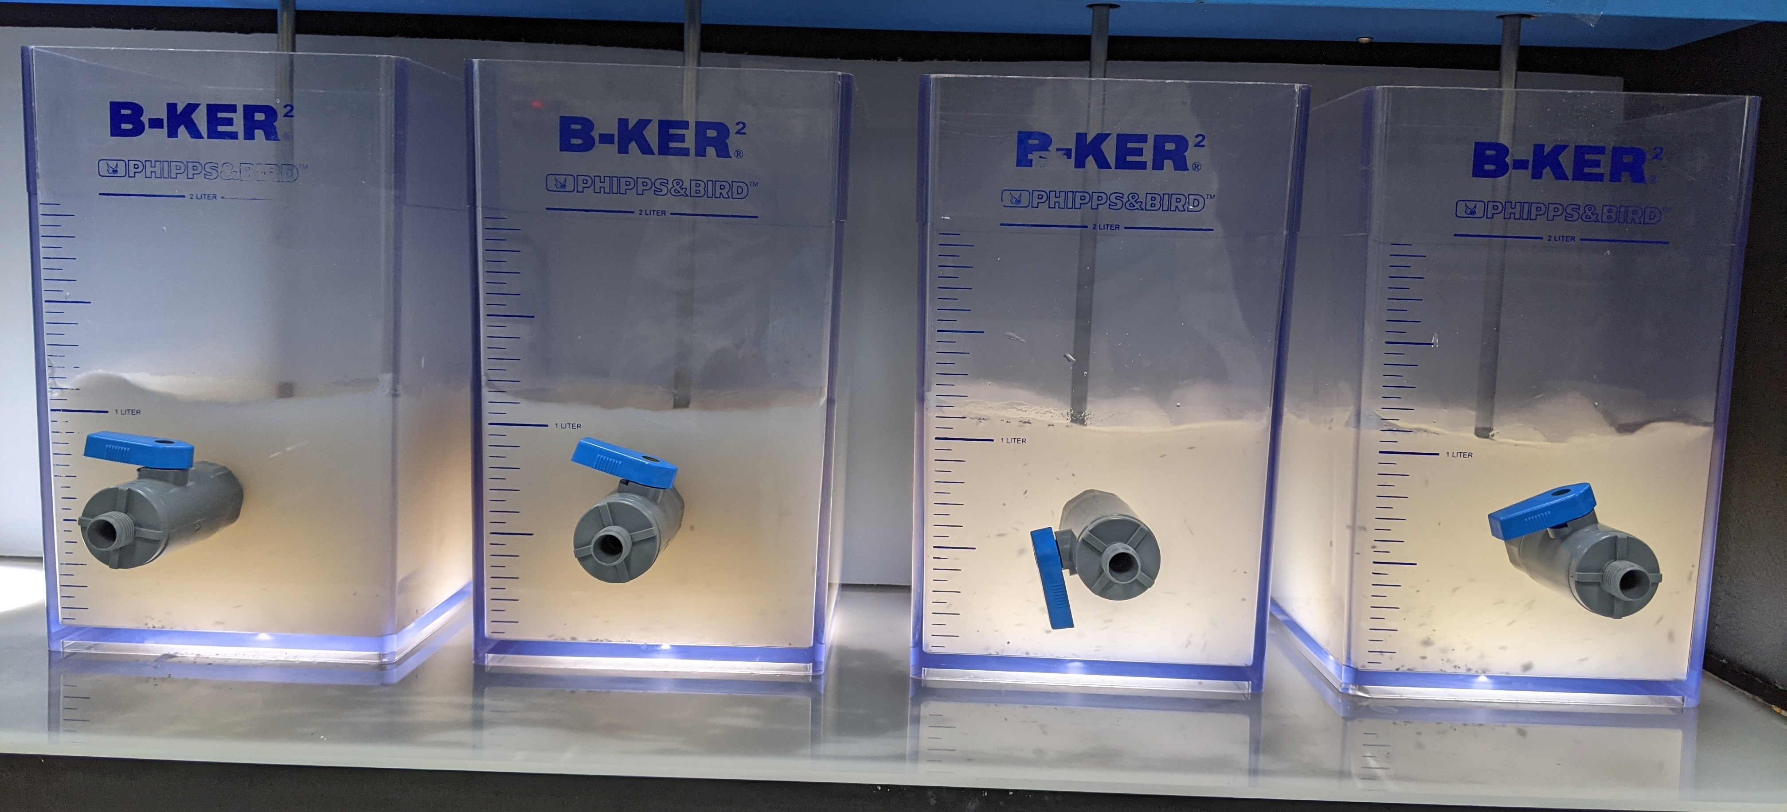
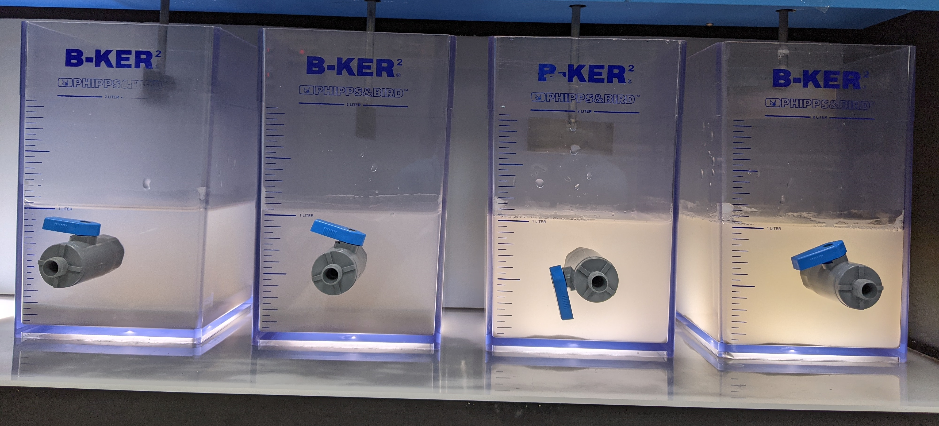
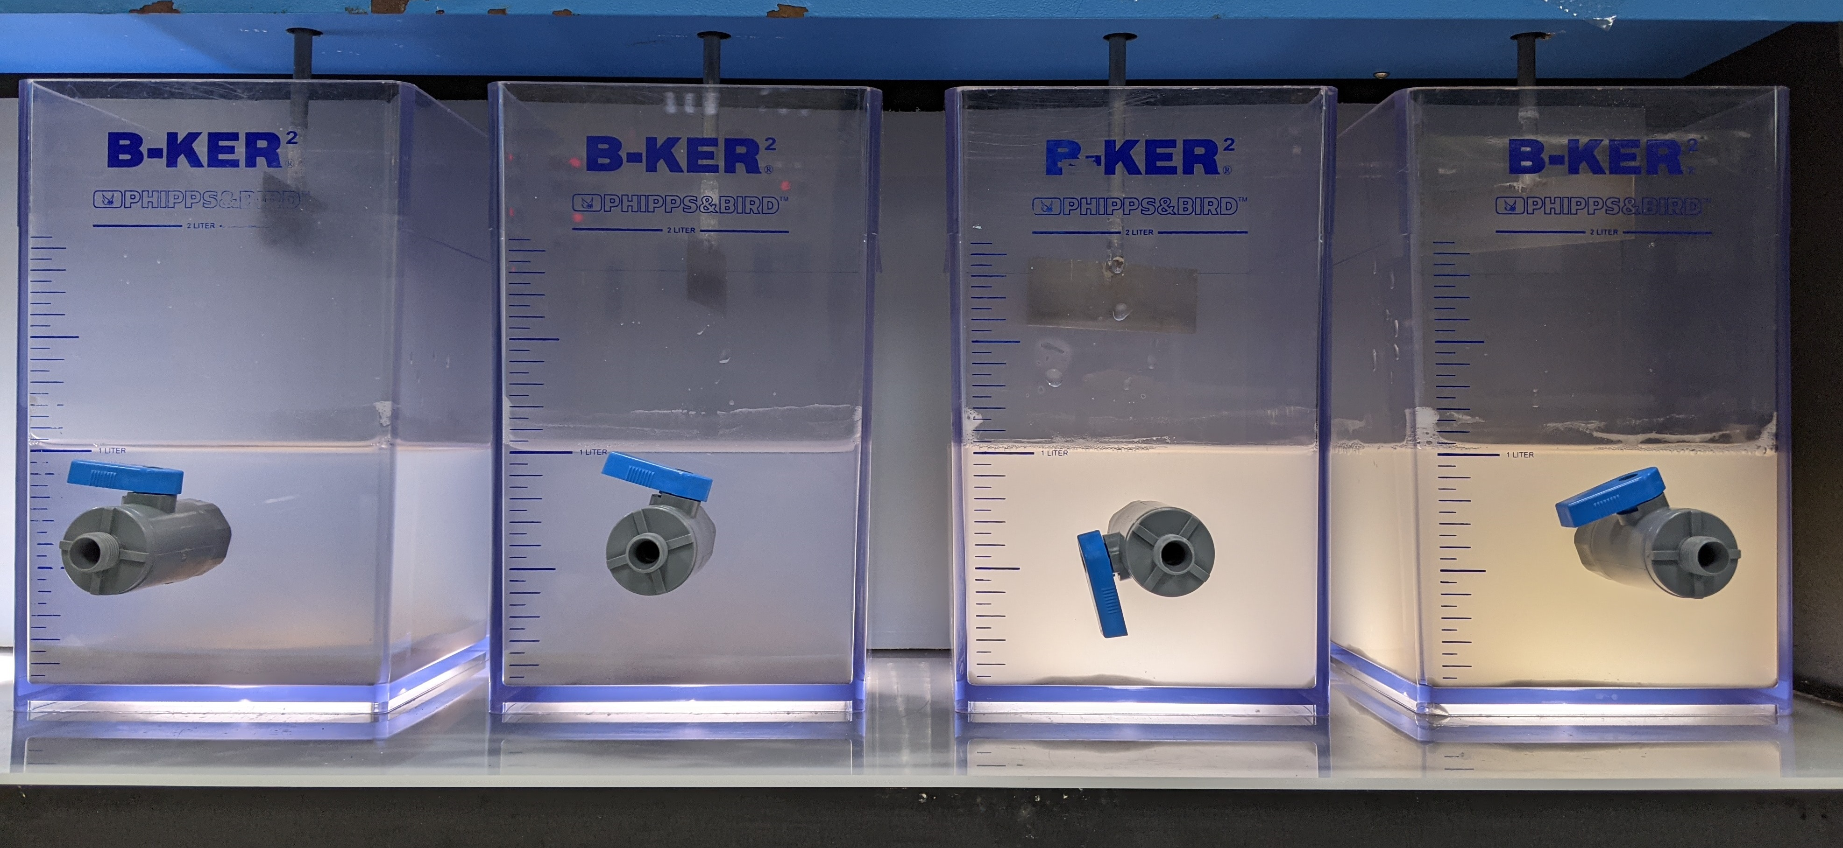
Jar testing of Synthetic Combined NF RO Reject (with pH adjustment – Testing 2
Synthetic combined reject solution in different jars, with added different chemicals. Jar 1 from the left most to jar 4 in right most.
Starting of settling
End of settling

Slide 11
Jar testing of Synthetic Combined NF RO Reject (with pH adjustment – Testing 2
Chemical precipitation with Ca(OH)2 (lime) and CaCl2
Jar | Chemical dosage | pH
 |  | t = 10 min | t = 20 min | t = 30 min
1 | 10,000 ppm lime | 12.52 | 12.59 | 12.62
2 | 12,000 ppm lime | 12.65 | 12.70 | 12.71
3 | 5,000 ppm lime + 5,000 ppm CaCl2 | 2.04 | 2.08 | 2.13
4 | 6,000 ppm lime + 6,000 ppm CaCl2 | 2.38 | 2.94 | 4.81
Coagulation and flocculation with 1 mg/L anionic polymer
Jar | Chemical dosage | pH |  |  | Polymer used
 |  | t = 2 min | t = 10 min | t = 30 min
1 | 10,000 ppm lime | 12.58 | 12.54 | 12.56 | Flopam AN 934 SH
2 | 12,000 ppm lime | 12.67 | 12.72 | 12.65 | Flopam AN 934 SH
3 | 5,000 ppm lime + 5,000 ppm CaCl2 | 2.13 | 2.13 | 2.09 | Flopam AN 934 SH
4 | 6,000 ppm lime + 6,000 ppm CaCl2 | 6.21 | 6.29 | 6.48 | Flopam AN 934 SH

Slide 12
Jar testing of Synthetic Combined NF RO Reject (with pH adjustment – Testing 2
Jar | Polymer added | Chemicals dosage | Supernatant turbidity (NTU)
1 | Flopam AN 934 SH | 10,000 ppm lime | 20.8
2 | Flopam AN 934 SH | 12,000 ppm lime | 74.2
3 | Flopam AN 934 SH | 5,000 ppm lime + 5,000 ppm CaCl2 | 430
4 | Flopam AN 934 SH | 6,000 ppm lime + 6,000 ppm CaCl2 | 496
Elements | Concentration based on in-house measurement (ppm) | Supernatant quality for Jar 1 | Supernatant quality for Jar 2 | Supernatant quality for Jar 3 | Supernatant quality for Jar 4
pH | 3.5 | 12.56 | 12.65 | 2.09 | 6.48
Conductivity | 6,375 µS/cm | 8,233 µS/cm | 10.64 mS/cm | 11.76 mS/cm | 10.43 mS/cm
TDS | 3,394 | 4,460 | 5,867 | 6,526 | 5,745
NH4 | 65.8 | 57 | 59.4 | 68.4 | 72.6
F | 2,928 | 8.21 | 5.61 | 187 | 610
SO4 | 345 | 72.4 | 50.6 | 32 | 96.3
PO4 | 366 | <1 | <1 | 241 | 83
Cl | 211 | 191 | 164 | 2,939 | 3,548
Na | 500 | 353 | 343 | 365 | 402
Ca | 11.1 | 389 | 622 | 1,077 | 2,139
Si | 47.6 | <0.1 | <0.1 | 65.2 | 66.7

Slide 13
Jar testing of Synthetic Combined NF RO Reject (with pH adjustment – Testing 3
Jar | Polymer added | Chemicals dosage | Supernatant turbidity (NTU)
1 | Flopam AN 934 SH | 8000 ppm lime + 4000 ppm CaCl2 | 56.9
2 | Flopam AN 934 SH | 8000 ppm lime + 10000 ppm CaCl2 | 226
3 | Flopam AN 934 SH | 8000 ppm lime + 6000 ppm CaCl2 | 138
4 | Flopam AN 934 SH | 8000 ppm lime + 8000 ppm CaCl2 | 162
5 | Flopam AN 934 SH | 6000 ppm lime + 4000 ppm CaCl2 | 22
Elements | Concentration based on in-house measurement (ppm) | Supernatant quality for Jar 1 | Supernatant quality for Jar 2 | Supernatant quality for Jar 3 | Supernatant quality for Jar 4 | Supernatant quality for Jar 5
pH | 3.5 | 11.96 | 11.91 | 12.03 | 11.91 | 9.8
Conductivity | 6,375 µS/cm | 8889 µS/cm | 17.23 mS/cm | 11.93 mS/cm | 14.4 mS/cm | 7756 µS/cm
TDS | 3,394 | 4844 | 9824 | 6624 | 8108 | 4180
NH4 | 65.8 | 61.8 | 54.1 | 52.9 | 46.4 | 59.3
F | 2,928 | 9.15 | 13 | 29.1 | 14 | 14.2
SO4 | 345 | 116 | 117 | 114 | 114 | 106
PO4 | 366 | <1 | <1 | 3.14 | <1 | <1
Cl | 211 | 2258 | 5414 | 3515 | 4316 | 2376
Na | 500 | 440 | 496 | 440 | 434 | 429
Ca | 11.1 | 1098 | 2858 | 1738 | 2263 | 920
Si | 47.6 | 0.149 | 0.342 | 0.863 | 0.356 | 10.5

Slide 14
Preparation of Synthetic Combined NF RO Reject Solution (without pH adjustment)
Preferred chemicals | Required quantity for 1 Liter solution (gram)
NH4Cl | 0.209
NaCl | 0.011
CaCl2 | 0.049
HF | 2.242
H3PO4 | 0.367
SiH2O3 | 0.128
H2SO4 | 0.362
Elements | Desired concentration (ppm) | Calculated concentration based on added chemicals (ppm) | Concentration based on in-house measurement (ppm)
pH | 1.9 | - | 3
Conductivity | - | - | 7745 µS/cm
TDS | - | - | 4175
NH4 | 70.6 | 70.6 | 63
F | 2129 | 2129 | 2304
SO4 | 355 | 355 | 336
PO4 | 356 | 356 | 389
Cl | 177 | 177 | 234
Na | 17.6 | 4.49 | 7.74
Ca | 17.7 | 17.7 | 7.94
Si | 46.2 | 46.2 | 41.2

Slide 15
Jar testing of Synthetic Combined NF RO Reject (without pH adjustment)– Testing 1
Jar | Polymer added | Chemicals dosage | Supernatant turbidity (NTU)
1 | Flopam AN 934 SH | 6000 ppm lime + 500 ppm CaCl2 | 9.98
2 | Flopam AN 934 SH | 6000 lime + 4000 ppm CaCl2 | 20.4
Elements | Concentration based on in-house measurement (ppm) | Supernatant quality for Jar 1 | Supernatant quality for Jar 2
pH | 3 | 9.68 | 9.29
Conductivity | 7745 µS/cm | 1941 µS/cm | 7256 µS/cm
TDS | 4175 | 974.7 | 3889
NH4 | 81.2 | 91.5 | 65.7
F | 2304 | 22 | 7.51
SO4 | 336 | 150 | 137
PO4 | 389 | <1 | <1
Cl | 234 | 456 | 2227
Na | 7.74 | 8.2 | 25.4
Ca | 7.94 | 295 | 1290
Si | 41.2 | 14.9 | 5.66

Slide 16
Preparation of Synthetic HFW+NH4F with IPA (with pH adjustment)
Preferred chemicals | Required quantity for 1 Liter solution (gram)
NH4Cl | 0.059
NaCl | 0.013
CaCl2 | 0.014
HF | 0.843
H3PO4 | 0.206
SiH2O3 | 0.039
H2SO4 | 0.102
IPA | 1
Elements | Desired concentration (ppm) | Calculated concentration based on added chemicals (ppm) | Concentration based on in-house measurement (ppm)
pH | - | - | 3.5
Conductivity | - | - | 3,357 µS/cm
TDS | - | - | 1,134
NH4 | 20 | 20 | 19.7
F | 800 | 800 | 819
SO4 | 100 | 100 | 100
PO4 | 200 | 200 | 214
Cl | 50 | 55.86 | 54.3
Na | 5 | 5 | 721
Ca | 5 | 5 | 1.49
Si | 14.02 | 14.02 | 12.7
COD | - | - | 2,450
TOC | - | - | 473
IPA | 1,000 | 1,000 | 1000

Slide 17
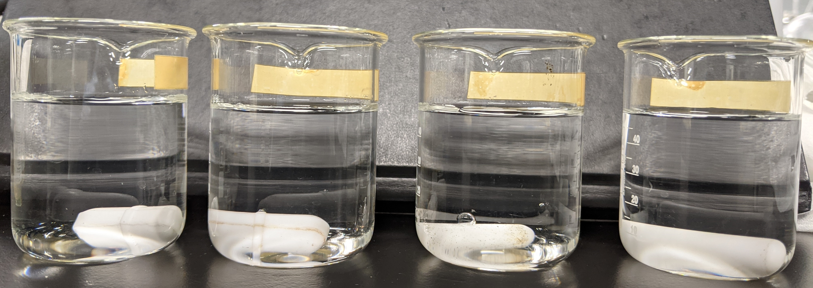
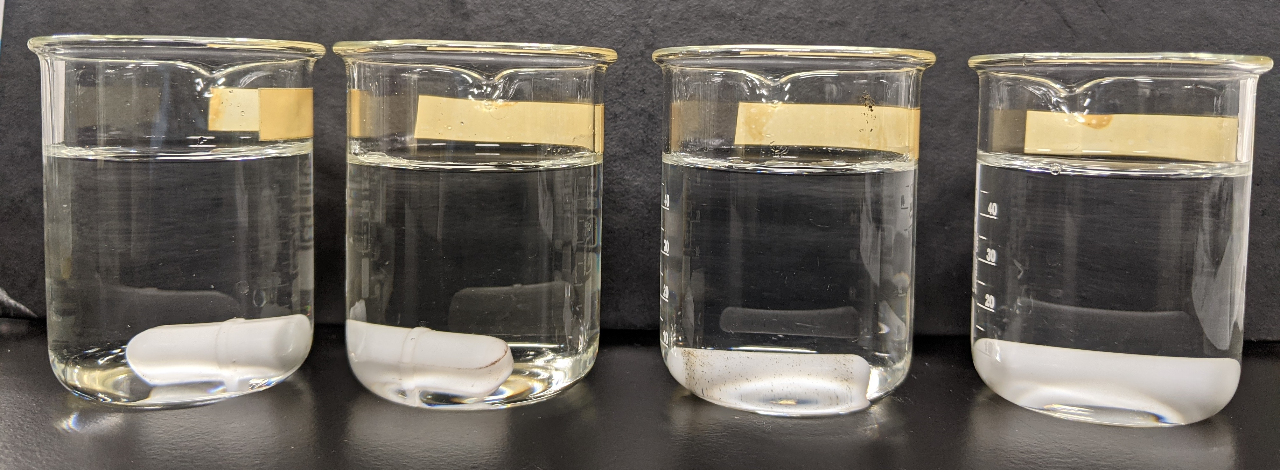
Anti-scalant compatibility test - NF filtration of HFW+NH4F with IPA (with pH adjustment)
Initial solution pH: 3.3, pH adjusted to 3.5
Anti-scalant | pH | Solution appearance
Flocon 260 | 3.0 | Clear
Avista Vitec 3000 | 7.19 | Clear
Avista Vitec 5100 | 3.7 | Clear
Avista Vitec 7400 | 3.58 | Clear
Avista vitec 7400 was selected for the NF filtration experiment because its addition into the feed solution didn’t alter the solution pH much.

Slide 18
Result - NF filtration of HFW+NH4F with IPA (with pH adjustment)
Operating conditions
Batch mode (using Dupont NF90 membrane)
75% recovery
100 psi operating pressure, increased pressure over time as feed gets more and more concentrated
Observation: Membrane flux was lower after the NF filtration.
Before NF: 15.1g in 3 min (filtration using DI water
After NF: 6.1g in 3 min

Slide 19
Result - NF filtration of HFW+NH4F with IPA (with pH adjustment)
Elements | Concentration for synthetic feed (ppm) | Concentrated feed (ppm) | Permeate (ppm)
pH | 3.5 | 5.04 | 3.29
Conductivity | 3,357 µS/cm | 9,022 µS/cm | 708.6 µS/cm
TDS | 1,134 | 4,921 | 344.4
NH4 | 19.7 | 50.1 | 12.2
F | 819 | 1,555 | 144
SO4 | 100 | 389 | 3.83
PO4 | 214 | 637 | 1.55
Cl | 54.3 | 178 | 21
Na | 721 | 2082 | 86
Ca | 1.49 | <0.1 | <0.1
Si | 12.7 | 73.9 | 51.9
COD | 2,450 | 3935 | 1580
TOC | 473 | 870 | 382
IPA | 1000 | 1640 | 658

Slide 20
Preparation of Synthetic HFW+NH4F with IPA (without pH adjustment) – Trial 1
Preferred chemicals | Required quantity for 1 Liter solution (gram)
NH4Cl | 0.059
NaCl | 0.013
CaCl2 | 0.014
HF | 0.843
H3PO4 | 0.206
SiH2O3 | 0.039
H2SO4 | 0.102
IPA | 1
Elements | Desired concentration (ppm) | Calculated concentration based on added chemicals (ppm) | Concentration based on in-house measurement (ppm)
pH | - | - | 2.92
Conductivity | - | - | 3371 µS/cm
TDS | - | - | 1741
NH4 | 20 | 20 | 20
F | 800 | 800 | 802
SO4 | 100 | 100 | 101
PO4 | 200 | 200 | 161
Cl | 50 | 55.86 | 147
Na | 5 | 5 | 10.1
Ca | 5 | 5 | 4.6
Si | 14.02 | 14.02 | 9.15
COD | - | - | 2523
TOC | - | - | 588
IPA | 1,000 | 1,000 | 1000

Slide 21
Result - NF filtration of HFW+NH4F with IPA (without pH adjustment) – Trial 1
Operating conditions
Batch mode (using Trisep TS40 NF membrane)
75% recovery
100 psi operating pressure, increased pressure over time as feed gets more and more concentrated

Slide 22
Result – NF and RO filtration of HFW+NH4F with IPA (without pH adjustment) – Trial 1
Elements | Concentration for synthetic feed (ppm) | NF concentrated feed (ppm) | NF Permeate (ppm) | RO permeate (ppm)
pH | 2.92 | 2.08 | 2.26 | 2.53
Conductivity | 3371 µS/cm | 4821 µS/cm | 3071 µS/cm | 1382 µS/cm
TDS | 1741 | 2535 | 1580 | 685.3
NH4 | 20 | 61 | 9.1 | 1.0
F | 802 | 1328 | 456 | 278
SO4 | 101 | 201 | 88.9 | 3.45
PO4 | 161 | 203 | 150 | 1.21
Cl | 147 | 152 | 147 | 24.8
Na | 10.1 | 30.9 | 4.72 | 4.34
Ca | 4.6 | 21.5 | 0.105 | <0.1
Si | 9.15 | 41.5 | 4.19 | 0.233
COD | 2523 | 2970 | 2013 | 67
TOC | 588 | 691 | 484 | 16.2
IPA | 1000 | 1238 | 839 | 28

Slide 23
Result - NF filtration of HFW+NH4F with IPA (without pH adjustment) – Trial 2
Operating conditions
Batch mode (using Trisep TS40 NF membrane)
75% recovery
100 psi operating pressure, increased pressure over time as feed gets more and more concentrated

Slide 24
Result – NF and RO filtration of HFW+NH4F with IPA (without pH adjustment) – Trial 2
Elements | Concentration for synthetic feed (ppm) | NF concentrated feed (ppm) | NF Permeate (ppm) | RO concentrated feed (ppm) | RO permeate (ppm)
pH | 2.15 | 2.3 | 2.3 | 2.31 | 2.9
Conductivity | 3376 µS/cm | 3298 µS/cm | 1905 µS/cm | 2416 µS/cm | 493.1 µS/cm
TDS | 1730 | 3001 | 945.5 | 1230 | 214.4
NH4 | 20.4 | 67 | 9.7 | 17.6 | 1.3
F | 813 | 1959 | 203 | 333 | 48.5
SO4 | 102 | 299 | 55 | 11.6 | 0.286
PO4 | 187 | 4.3 | 72 | 9.59 | <0.1
Cl | 147 | 265 | 140 | 131 | 8.77
Na | 2.6 | 30.45 | <0.1 | <0.1 | <0.1
Ca | 6.5 | 25.2 | 1.8 | 1.73 | <0.1
Si | 12.2 | 39.5 | 3.4 | 9.69 | 0.221
COD | 2390 | 3456.7 | 1533.3 | 2791.67 | 27.33
TOC | 570 | 812 | 369 | 656 | 7.58
IPA | 1000 | 1024 | 639 | 1163 | 11

Slide 25
Result – NF and RO filtration of mixed HFW wastewater from EQ Tank – Trial 1
Elements | Mixed wastewater from EQ tank (mg/L) | NF concentrate (mg/L) | NF Permeate (mg/L) | RO concentrate (mg/L) | RO permeate (mg/L) | Toyobo reject (mg/L) | Toyobo permeate (mg/L)
pH | 2.8 | 3.26 | 3.21 | 3.73 | 3.13
Conductivity | 2267 µS/cm | 4123 µS/cm | 805.7 µS/cm | 2237 µS/cm | 292.6 µS/cm
TDS | 1158 | 2276 | 394 | 1131 | 139 | 1555 | 536
NH4 | 65.7 | 150 | 28.9 | 113 | <1 | 102 | 13.5
F | 372 | 1002 | 95.1 | 291 | 23.0 | 450 | 171
SO4 | 1999 | 1168 | 34.5 | 140 | 0.23 | 591 | 74.2
PO4 | 4.54 | <5 | 1.27 | <5 | <0.1 | <5 | <1
Cl | 65.1 | 91.3 | 50.8 | 213 | 2.63 | 140 | 26.8
Na | 219 | 512 | 67.8 | 196 | <0.1 | 319 | 46.3
Ca | 3.79 | 12.3 | <0.1 | <0.1 | <0.1 | 5.96 | <0.1
Si | 25.3 | 50.4 | 15.1 | 54.8 | <0.1 | 40.7 | 2.76
COD | 278 | 150 | 70 | 275 | <10 | 175 | 50
TOC | 24 | 39.9 | 19.1 | 62.7 | 2.60 | 41.5 | 11.3
IPA | 26.5 | - | - | - | - | - | -

